Slide 1
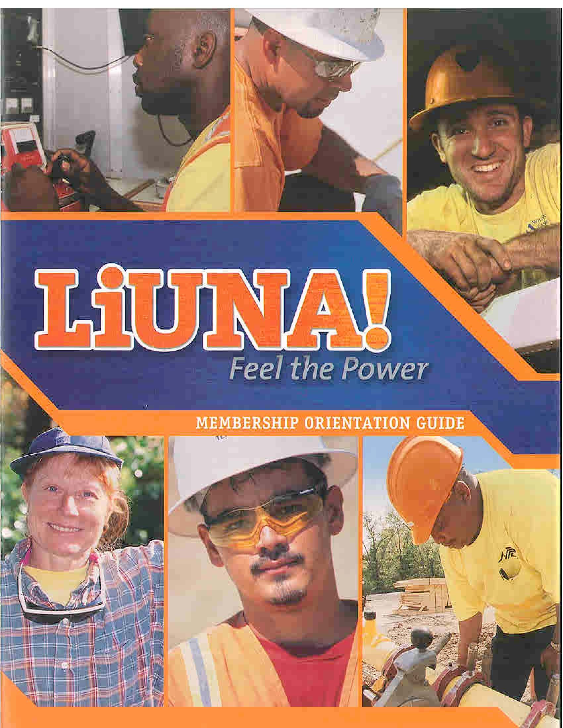
Local X
Member Orientation Session
8/14
Notes:
This is a generic member orientation session. Use in conjunction with LIUNA’s Membership Orientation Guide featured above.
Adjust the content within these slides to suit your needs and membership/industry composition. Add more slides and sections to cover material you want to add. Slides that you would prefer not to use you can “hide” or delete.
As much as possible include pictures of members and events from your own Local, District Council or Region.
Notes pages are included on each slide to guide you.

Slide 2
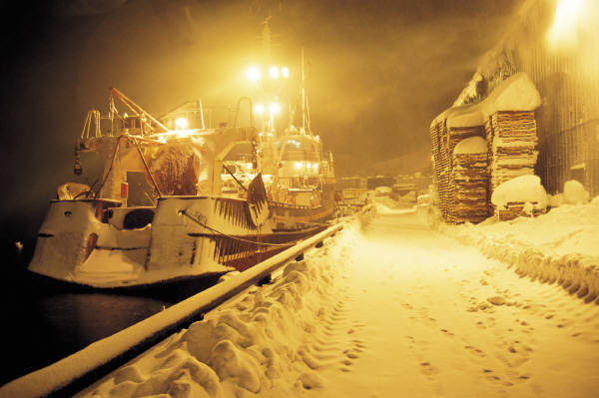
Icebreaker Who We Are – Why We’re Here
How did you become a union member?
What do you think the labor movement is all about?/What do you believe the union can do for you and others?
Notes:
General Welcome; Use this as an opportunity to get students talking.
Emphasize why the Union is doing this program.
If time, and if the class is small enough, each person introducing him/herself can respond to these questions. If not enough time, get a few responses from the class to each question. Use responses to find out their common beliefs about the labor movement and their expectations as members.
Alternative – Small Group Discussion
Questions are provided separately to provoke member’s thoughts and baseline knowledge of several topics that will be addressed.

Slide 3
Program Overview
Labor history
Laborers history
Laborers Local X Operations
Services and benefits
Member rights and responsibilities
Notes:
Adjust program overview slides as necessary to reflect content of the class.
Review the intent of the program and what will get covered.
Include timing (if long session or multiple days) as well as breaks and meals as appropriate.

Slide 4
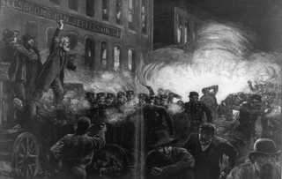
Labor History
1886 - Haymarket Square in Chicago
Notes:
Title page to introduce the discussion about labor history.
Ask: Why do we start with the labor movement’s history?
Get some responses.
Answer: You can’t understand/appreciate where you are or where you are headed until you know your past.
If there is time briefly tell them about the Haymarket Square Massacre. The Massacre and the other historical events can be easily researched on the internet and are found in every labor history book.

Slide 5
What Comes to Mind?
John D. Rockefeller
Andrew Carnegie
J.P. Morgan
Notes:
Ask them: “What comes to mind when you look at this picture?”
Responses should reflect something to do with those that have and those that have not.
These were the “haves”; the Robber Barons of the late 1800s:
Rockefeller: Oil
Carnegie: Steel
JP Morgan: Banking/Railroads
Reflect on the differences between the “haves” and “have nots”. With immigration, the “haves” pitted one group of workers against the other (Irish vs. Italians vs. Blacks vs. Mexicans, etc) in a divide and conquer method.
Point: While some form of unions were around even in the 1700s, the labor movement as we know it today (local unions, national unions and labor federations) were developed during this time period in the mid and late 1800s.
If time, ask: How is this similar to what happens today?
Note how corporate interests work to get working people to fight amongst themselves and support corporate causes at the expense of their own economic self interest.

Slide 6
Early Issues for Workers & Their Unions
Hours of work
8 hours/day
Factory conditions
Child labor
Voting rights
Public Education
Mourners after Triangle Shirtwaist Factory fire
Notes:
Ask what they think the issues were in those days. While pay always an issue, many of Labor’s causes were also social issues. Social leaders were also Labor leaders. Labor leaders were community leaders.
If time, briefly tell them about the Triangle Shirtwaist Factory Fire (1911).

Slide 7
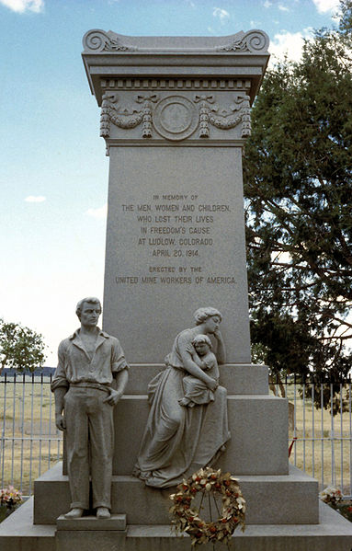
Consequences of Union Activity
Fired
Blackballed
Run out of town
Arrested
Fined
Killed
Ludlow Massacre Memorial
No permissible labor law until 1935
Notes:
Ask (or summarize) what they think happened to labor leaders (or followers) in those days.
They fought for things we take for granted today at great personal risk.
Forming a union wasn’t even legal in the 1800s. The law that specifically gives us the right to organize didn’t get passed until the 1930s.
If time, briefly tell them about of the Ludlow Massacre (1914).

Slide 8
Workers Right to Form Unions
National Labor Relations Act 1935***
Workers have the right to form a union
Select a representative of their choosing
For purposes of bargaining collectively with their employer
About their wages, hours and conditions of employment
*** but employers violate this right routinely with little to no penalties.
Notes:
This slide clarifies points raised in the previous slide. Briefly explain relevance of enabling labor law to our ability to represent workers.
Briefly review the major elements of the NLRA. Intent was to give workers the right to join unions and bargain collectively. However, today it is grossly abused.
If time, relate to our recent, yet unsuccessful, efforts to pass the Employee Free Choice Act; why reform is important.

Slide 9
What are these? Where did they come from?
Social Security
retirement and disability income
Medicare and Medicaid
health insurance for the elderly and poor
Unemployment Insurance
Minimum Wage; Overtime after 40 hours
Equal Employment non-discrimination laws
Civil Rights Act 1964
Workplace safety and health standards (OSHA)
Family Medical Leave Act
Americans with Disabilities Act
Notes:
Use this slide to emphasize the value of organized labor to them and all workers today. These laws that protect all workers wouldn’t have gotten passed without the help of organized labor. Many Americans take these laws for granted.
Zero in on a few of them that will resonate well with the class.
Examples: Civil Rights Act or OSHA.

Slide 10
Unions Today
More than 60 national unions
More than 14.5 million union members
More than 16 million represented by unions
All working people benefit from a union’s presence
Notes:
Describe the overall scope of the labor movement. Ask if they have family members who are members of other unions. Which ones?
Ask them to name some other unions they may be familiar with or may have previously belonged to.
Explain the last bullet in more depth: that unions set standards that non-union employers try to match, often to attract workers or to keep their workplace union free.
Update union membership statistics (2011) as necessary (www.bls.gov).

Slide 11
LIUNA History
International Hod Carriers and Building Laborers Union: 1903
Shunned by other skilled craft unions
Unskilled and ethnically diverse
Notes:
Now lets talk about our own union. When and how we were chartered by the American Federation of Labor:
Discuss the original name of LIUNA (Ask: does anyone know what a hod carrier is?) Discuss the kind of work and the kind of demographics of Laborers in those days: Hard unskilled work, easily replaceable if you complained or refused bad conditions; Ethnically diverse (as we are today).
Formed because the other skilled craft unions that Laborers worked with didn’t want us in their unions. Irony: today LIUNA is considered to be one of the best among the building trades and the labor movement in general.
If time show LIUNA 100 Year Anniversary video or 2011 Convention history clips.

Slide 12
Local X’s Union History
Charter date:
Major events at the time
Original membership
Original industry composition
Notes:
Revert to information about your own Local Union’s history. Relay the circumstances under which your Local Union was chartered.
Try to get a few historical stories to share, pictures, old tools and methods of work.

Slide 13
LIUNA’s Expansion into New Industries
Public Sector (1960s)
Service Contract Workers (1970s)
Health Care (1970s)
Environmental (1980s)
Green Construction (2000s)
Notes:
Over the years LIUNA expanded into new industries as opportunities arose. Discuss expansion of public sector jobs, health care jobs, etc and corresponding legislation that allowed for organizing in those areas. For mixed or non construction locals, emphasize growth outside traditional construction membership during these time periods.
Moral of the story: LIUNA is a diversified union and is willing to adapt to change and seize opportunities has contributed to its survival.

Slide 14
2013 LIUNA Membership Breakdown
2013 Membership | %
Construction | 57.6
Public Service | 9.4
Mail Handlers | 7.3
Industry/Plant | 3.9
Service Contracts | 1.7
Health Care | 3.2
Other | 2.3
Retired | 14.4
Total Membership:
447,559
Notes:
Still primarily a construction union but diversified in other industries as well
Note that where we represent workers is where we are getting hit the worst: construction, public sector, postal

Slide 15
LIUNA’s Structure
IU
9 Regional Offices
Canadian Sub-Region
District Councils
(44)
Local Unions
(379)
Mailhandlers
Organizing Funds
Bargaining Units
Bargaining Units
Bargaining Units
Notes:
Discuss what LIUNA’s overall structure looks like. Discuss what each of these bodies do and how they relate to one another. Identify the specific bodies of relevance to the class, their District Council, Region etc. Identify the officers of these bodies. More information on these bodies is in the Membership Orientation Guide.
Briefly explain LIUNA’s relationship to AFL-CIO as a federation.

Slide 16
Local Union Governance and Operations
The Uniform Local Union Constitution is the guiding document for our operations.
Notes:
This section segues into discussing how the Local Union operates. Much of what follows is covered in the Constitution. Explain what the Constitution is.

Slide 17
Local X Officers
Executive Board
Business Manager
President
Vice President
Secretary-Treasurer
Recording Secretary
2-3 more
Notes:
Explain that the Local Union is run through an Executive Board. The EBoard meets monthly.
Name their officers and explain what each of them is responsible for.
Note that the responsibilities are listed in the Uniform Local Union’s Constitution.
These officers are voted on by the membership every 3 years.

Slide 18
Local X’s Representatives
Field Agents or Representatives
Organizers
Stewards
Auditors *
Sergeant at Arms *
Dispatcher
Admin staff
*elected by the members
Notes:
Review these other positions as well. Consider listing/naming the field reps on a separate slide. Introduce those that are in the room.
Identify the additional people that are also relevant to the class; e.g. the bookkeeper or dispatcher.
Add more as necessary for your Local Union.

Slide 19
Monthly Local Union Meetings
Date:
Time:
Expectations:
Members have the right to “attend and
participate in meeting and functions of the
Local Union”
Notes:
Discuss the details of the membership meeting.
Emphasize that this is where the business of the union is conducted.
As members they have a voice in the direction of the union.
Informally this is a chance to hear about what is going on and to meet fellow members.

Slide 20
Local X Operations
Hours of operation:
Hiring hall process:
Office Contacts:
Dues:
Notes:
Review the fundamental operations of the Local Union.
Who to contact, when jobs are dispatched, how the dues works: when due, suspensions, etc.
Use multiple slides as necessary.

Slide 21
Laborers’ Local X Services
Job referral/hiring hall
Bargain your wages and benefits
Included in your contract or collective bargaining agreement
Other terms and conditions of work
Show up pay, tool allowance, water on the job, etc.
In your contract or in a pre-job agreement
Represent members whose rights are violated
Grievance procedure and arbitration
Notes:
Review in more detail the services of your particular Local Union.
Explain the hiring hall rules and processes.
Explain what a collective bargaining agreement is; what’s in it.
Explain what it means to represent workers when there is a problem; describe common issues that the agents may get involved in.
Use multiple slides as necessary to deliver these points in more detail.

Slide 22
Local Union Dues
Monthly Dues: $/month
Working Dues: insert formula
Important to be on time.
Notes:
Explain how dues structure works, including check-off.
Dues must be in by the last day of the following month when due or members are automatically suspended.
Explain process and cost of readmission.

Slide 23
How Your Union Dues Are Spent (create pie chart or list percentage for your local)
Notes:
Create a pie chart that shows how the Local Union’s dues are spent.
Use categories with names that members will understand; not necessarily each line item of your financial report.
Emphasize that the benefits and services of the union are dependant on dues.
Financial Reporting: Concerns about what dues are spent on are addressed at the Local Union membership meetings. Each month a financial report is delivered at the Local Union meeting.

Slide 24
Laborers Local X Member Benefits
Health Insurance
Pension
Training
Legal Services
Notes:
Overview of benefits.
Adjust to reflect Local Union’s offerings: add more or delete as necessary.
More detail on the traditional benefit funds follows.

Slide 25
Health Plan*
# Hours of work to qualify for coverage
# hours for continuing coverage
Covers spouses and dependents
Transportable from job to job
Negotiated contributions
* General summary description only
Notes:
Modify to match terms of your health plan. Make sure you have handouts with more information on plan benefits and contacts.
Explain funding through what the union bargains to into the “pool.”

Slide 26
Health Plan*
Summary of coverage
Hospitalization
Doctors visits
Immunizations
X-rays and diagnostic tests
Think you don’t need this?
Think again!!!
*General summary description only
Notes:
Modify as necessary. Important that the value of this benefit is emphasized.

Slide 27
Pension Plan*
# Credits for coverage
Minimum age:
Vested after # years
Think you don’t need this?
Think again!
*General summary description only
Notes:
Modify to suit terms of your pension plan. Impress upon them importance and value of this benefit.

Slide 28
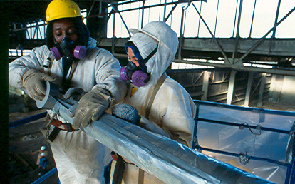
Training Benefits
Location of training center(s)
Classes offered:
Scaffolding
Blueprint reading
Pipeline
OSHA 10
Etc.
No cost to the member
Think you don’t need this?
Think again!
Notes:
More detail on the training center. Modify to match classes offered for your members. Emphasis value of this benefit.

Slide 29
What Else Laborers Local X Does
Organizes more workers
More members means more power/better protections for you
Organizes more employers
More union employers means more jobs for you
Political action
More labor friendly politicians means better laws for you
Coalition building/public service
Community allies and better communities to live in
Notes:
Discuss other activities that the Local Union is involved in. Show how these activities impact their own job security or pay.

Slide 30
Our Role in the Industry
Laborers and Contractors need each other
Contractors
Laborers
Need
Need
Workers
Jobs
Notes:
Discuss the mutual dependency of union contractors and construction unions.
Contractors need skilled labor to be successful and will pay a premium for it.
Laborers need jobs.
It is in our best interest to ensure the quality of our membership so that union contractors, who are paying more per hour for Laborers, are able to secure more work.
Contractors are better off if they invest in a pool of healthy, well trained workers they can have continuing access to as they bid for work.

Slide 31
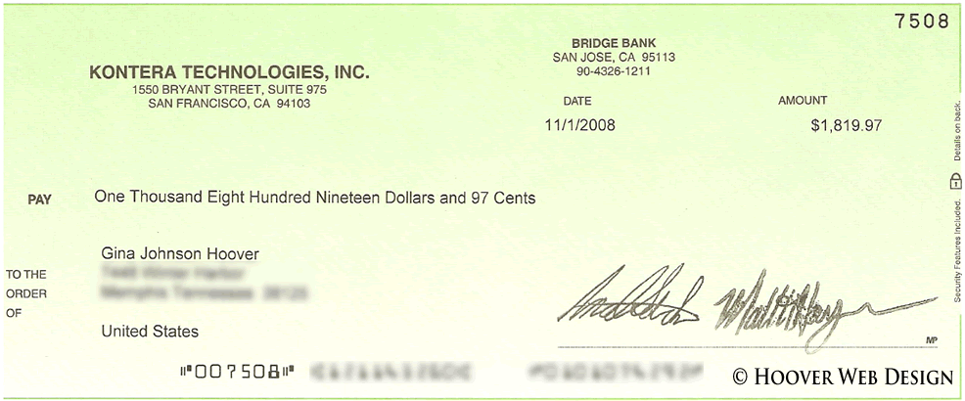
Jobs/Work Hours And Your Paycheck
Formula:
Job + Work hours x Pay rate = Paycheck
Notes:
Lets start with the basics; those things that affect what you get paid:
It’s a simple formula that you should recognize:
First you need a job; construction work needs to be available to contractors so they can hire construction workers.
Second, your contractors, those that employ union workers, need to win the awards to put you to work.
And the third factor is your hourly pay rate.
Put on a flip chart: Hypothetically:
Your union contract rate is $30/hour.
None of our union contractors have secured work; they lost all the bids to non union contractors.
$30 x 0 hours = ????
If the contract wage were $100/hour or $1000/hour it would be these same result. It’s all in the HOURS.

Slide 32
Why Would a Contractor Go/Stay Union?
Access to quality workforce
Hiring hall, training center
Efficient administration of benefits
Pooled multi-employer funds
Ability to meet government standards
Unions prevent cutting corners
Notes:
Discuss factors that make a contractor profitable or able to secure work. Things like efficient work operations, reputation, ability to complete jobs on time and under budget.
If time, ask them why they think a contractor, if given a choice, would go union or not. Otherwise, review with them these and other elements.
Our union can provide many advantages to a contractor:
Access to quality workers is primary. We provide this through our hiring halls and quality training programs.
Contractors that offer worker benefits can do so much more efficiently through our multi-employer benefit trust funds. Otherwise, a non union contractor would be saddled with an administrative nightmare trying to provide health insurance or retirement benefits to an intermittent workforce.
Not to be underestimated, a contractor’s reputation is everything. Contractors with repeated legal problems or regulatory violations not only are subject to fines but risk losing future business if clients do their homework. A union’s presence tends to minimize these problems because the contractor can’t easily cut corners on pay, safety, EEO requirements, etc.

Slide 33
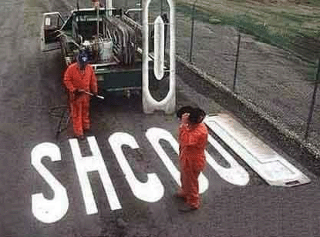
What Laborers Can Do to Get More Work
Non-Union Scale $18/hour
Union Scale $50/hour
Why Should a Contractor Hire You?
Notes:
What can you do as members to contribute to the success of our unionized employers and the success of the industry?
If time, get their responses. If not enough time, ask them to fill in.
Take advantage of training
Pride in their craft
Pride in their union: peer pressure
Provide full value for their time on the job
Be politically active to pass union construction-friendly legislation

Slide 34
Government Regulations
Construction Jobs
$$$$$$
Union Members
Government Officials
Enact
Create
How You Influence Government Policy
& Control Your Own Job Market
Elect
Employ
Notes:
Use this slide if time to emphasize last point on importance of political action. Otherwise skip
For better or worse, politics plays an important role in our everyday lives as citizens but it is even more important in construction
At all levels of government, local, state and federal, government officials and policy makers are making the rules that will impact:
The investment in construction jobs (infrastructure)
The standards by which contractors will be selected to get that work
What wages and other workplace standards must be in affect on those jobs.
And it is we citizens (you, your coworkers and families) that put the people in office who make these decisions.
[Go through this wheel chart with the class, starting with the union members and emphasizing each step around the circle.]

Slide 35
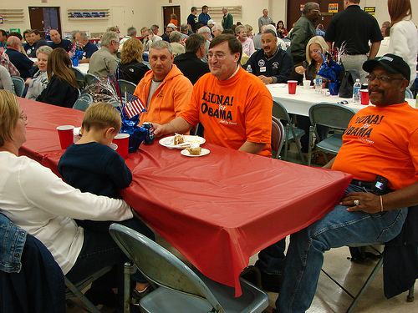
Member Activities
Walk picket lines
Attend rallies
Get out the vote
Annual picnic
Christmas party
Etc
Notes:
Modify as necessary. List the events and things that your Local Union or your District Council does that the members can get involved in.

Slide 36
Member Rights*
To participate in union activities
Freedom of speech
Set dues; authorize new spending
To see your collective bargaining agreements
To see union financial reports
To elect union officials
* Not complete; see Uniform Local Union Constitution for details
Notes:
Review of member rights (from the Uniform Local Union Constitution).

Slide 37
Member Responsibilities*
…To the Union
Attend union meetings
Attend union functions
Improve your skills
Provide constructive feedback
Maintain a unified front
Alert union reps of issues
Help out
Vote and encourage others to vote
* Not complete; there’s lots more to do!!
Notes:
It’s not a one way street. Members have a responsibility to participate in union functions. The union is not separate from the membership… the membership is the union.
If the members don’t involve themselves, they are letting someone else control their benefits and destiny. Discuss in detail the variety of ways members can help their union.

Slide 38
Code of Performance
Ensures members meet high standards
Attracts contractors to use LIUNA labor
Responsibilities to:
Maintain skills
“8” for “8”
Work safely
Be on time
More …
Notes:
Review terms of the Code of Performance and how it relates to their access to the hiring hall. Code was implemented in 2010 to keep LIUNA standards high and give contractors more reasons to go union.
Cover here or within section on hiring halls.

Slide 39
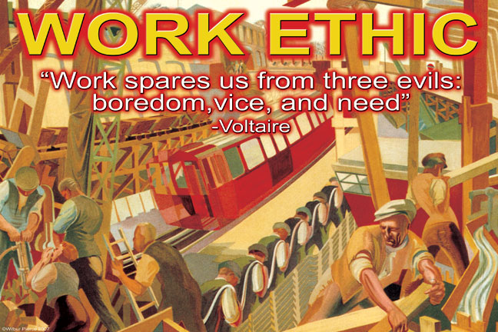
Member Workplace Responsibilities
All Union Members are judged by the
actions of other union members:
Work performance
Work ethic
Fitness in body and mind
Notes:
LIUNA advocates for a quality work product. Getting more work and better pay depends on LIUNA members seen by contractors as being a good investment. Construction is hard work; members need to take care of themselves.

Slide 40
Wrap Up
List one piece of information about the labor movement, LIUNA, or Local X that you learned in this session
What part of this session did you find most useful to you as a member of LIUNA Local X?
Notes:
Use this slide to conclude the program. Get feedback from the class as to what they got out of the presentation.

