Slide 1
Plated Desserts
John Kozar, Department Head
Chef John Folse Culinary Institute

Slide 2
About me…
Native of Latrobe, Pennsylvania
BS Applied Mathematics, 1983
AAS, Pennsylvania Culinary, 1992
Duquesne Club, Baker to Assistant Pastry Chef from 1993 to 1999
Beau Rivage, Assistant Pastry Chef, 1999-2002
CJFCI, 2002 – present
MBOE, Ohio State, 2009

Slide 3
What is Hospitality about?
Exceeding guests’ expectations!

Slide 4
Conceiving Plated Desserts
Appeal to the diner’s 5 senses:
Sight
Smell
Touch (Temperature, Texture)
Sound (Texture)
Taste
All of our senses carry positive or negative personal responses to the brain.

Slide 5
Sight
What do guests see when they enter a restaurant?
Décor
Other guests and their food
Servers
Menu

Slide 6
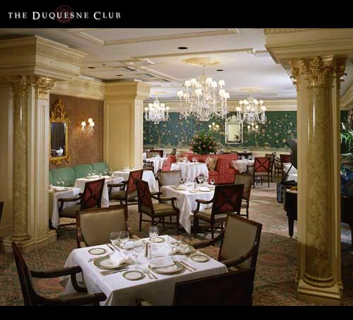
What are your expectations?

Slide 7
Seeing the actual dessert
Shapes
Elegant, unusual, attractive
Color
Various or monochromatic?
Neatness
Clean plate / No food on the rims?
Temperature ???!!
Sweaty / Melting
Frozen Cheesecake

Slide 8
Smell
A strong tie-in to memory
1st day of school
Fresh rain
Yeast dough
Freshly baked cinnamon rolls

Slide 9
What should the guest perceive at this point?
Freshness

Slide 10
Crème Brulee

Slide 11
Touch / temperature / texture
With spoon or fork
Resistance
Density
Mouth feel
Temperatures
Textures
Notes:
How much resistance should there be for:
Apple pie
Chocolate Cream pie
Bread Pudding
Rice Pudding
Crème caramel or Flan
Crème Brulee
Temperature for Hot Apple Pie a la mode
Textures – crispy, chewy, gummy!

Slide 12
Sound / texture
Anticipation…….
Crème Brulee crack!

Slide 13
Taste
Sweet
Salty
Sour
Bitter
Spicy
Notes:
What are good combinations?
Peanut butter cookies with Chocolate Chunks and Salted peanuts
Carrot cake with cream cheese frosting (with what Ice Cream?)

Slide 14
Sensory Chart

Slide 15
Chocolate Custard Spiced Island
With Macadamia Nut Cake, Passion Fruit Sauce, and Spicy Grissini
Chocolate-cardamom grissini
Nutmeg grissini
Bing Cherries, pitted & halved
Sliced green & red seedless grapes
Batonnets of fresh mango
Fresh basil leaves

Slide 16
Proper Planning Prevents Poor Performance
Custards baked and stored in cooler
Cakes baked, cut and stored in freezer
Grissini baked, stored in tightly sealed container with desiccant
Passion Fruit Sauce made and stored in cooler

Slide 17
Daily prep
Unmold custards and place on thawed cake circles
Cut fresh fruit

Slide 18
Service
Place custard/cake in center of plate.
Arrange cut fruit and basil on plate.
Pipe apricot jam on custard
Place grissini on top of apricot jam
Center star fruit on top of grissini
Sauce plate

Slide 19
Chocolate Custard Spiced Island

Slide 20
Analysis of Spiced Island

Slide 21
Inferno of Chocolate Espresso Mousse
Components:
Rich chocolate cake
Chocolate Espresso Mousse
Chocolate “Wrap”
Amaranth Hippen “Salad”
Cinnamon Sugar wavy sticks
Raspberry Coulis
Fresh fruit

Slide 22
Inferno of Chocolate Espresso Mousse

Slide 23
Pineapple Napoleon with Coconut Sorbet, Banana Soft Custard, and Caramel-Rum Sauce
Components:
Pineapple crisps
Coconut sorbet
Banana Crème Brulee
Caramel-Rum sauce
Buttercream
Pulled sugar leaves
Sugar cookie

Slide 24
Pineapple Napoleon with Coconut Sorbet, Banana Soft Custard, and Caramel-Rum Sauce

Slide 25
Blackberry Bavarian with White Chocolate Lattice and Spiced Citrus Sauce
Components:
Yellow cake base
Blackberry Bavarian
White Chocolate Lattice “Wrap”
Meringue Sticks
Sugar Rings
Spiced orange-honey sauce

Slide 26
Blackberry Bavarian with White Chocolate Lattice and Spiced Citrus Sauce

Slide 27
Hemisphere of Chocolate
Components:
Hazelnut cake circles
Chocolate mousse
Strawberry Crème Brulee
Apricot Nectar sauce
Poured sugar “plate”
Florentine cookies
White chocolate ring
Gold leaf

Slide 28
Hemisphere of Chocolate

Slide 29
Rice Pudding Mousse
Components:
Sesame Cake sticks
Rice Pudding Mousse
Mirabelle plums
Rhubarb crisps
Chocolate transfer sheet cutouts
Spun sugar

Slide 30
Rice Pudding Mousse

Slide 31
Pumpkin Mousse with Cabernet Sauvignon Sun-Dried Cherry Sauce
Components:
Miniature pumpkins, hollowed & roasted
Pumpkin mousse
Wine-cherry sauce
Chocolate Ties
Toasted Pecans

Slide 32
Pumpkin Mousse with Cabernet Sauvignon Sun-Dried Cherry Sauce

Slide 33
Chocolate and Banana Pate with Papaya Sorbet, Curl Cookies, and Chocolate Sauce
Components
Chocolate – Banana Pate
Chocolate sauce
Papaya sorbet
Red spun sugar nest
Hippen curl cookie
Papaya slices
White chocolate ring
Dark chocolate stick

Slide 34
Chocolate and Banana Pate with Papaya Sorbet, Curl Cookies, and Chocolate Sauce

Slide 35
White Chocolate Mousse and Raspberry Frost
Components:
Almond dacquoise
White chocolate mousse (with raspberries)
Lime Broth
Lime Zest
Chocolate Transfer curls
Hippen cookies

Slide 36
White Chocolate Mousse and Raspberry Frost

Slide 37
Banana and Star Anise Cream Tart with Chocolate Cigar and Sugar Smoke
Components:
Short dough cookies
Caramel-Orange sauce
Phyllo-wrapped bananas
Star Anise whipped cream
Banana slices (to be caramelized)
Chocolate cigars with sugar smoke
Batonnets of melons

Slide 38
Banana and Star Anise Cream Tart with Chocolate Cigar and Sugar Smoke

Slide 39
Review
Appeal to the guests’ 5 senses
Sight & Smell & Touch
Sound & Taste
5 P’s
Proper Planning Prevents Poor Performance

